Slide 1
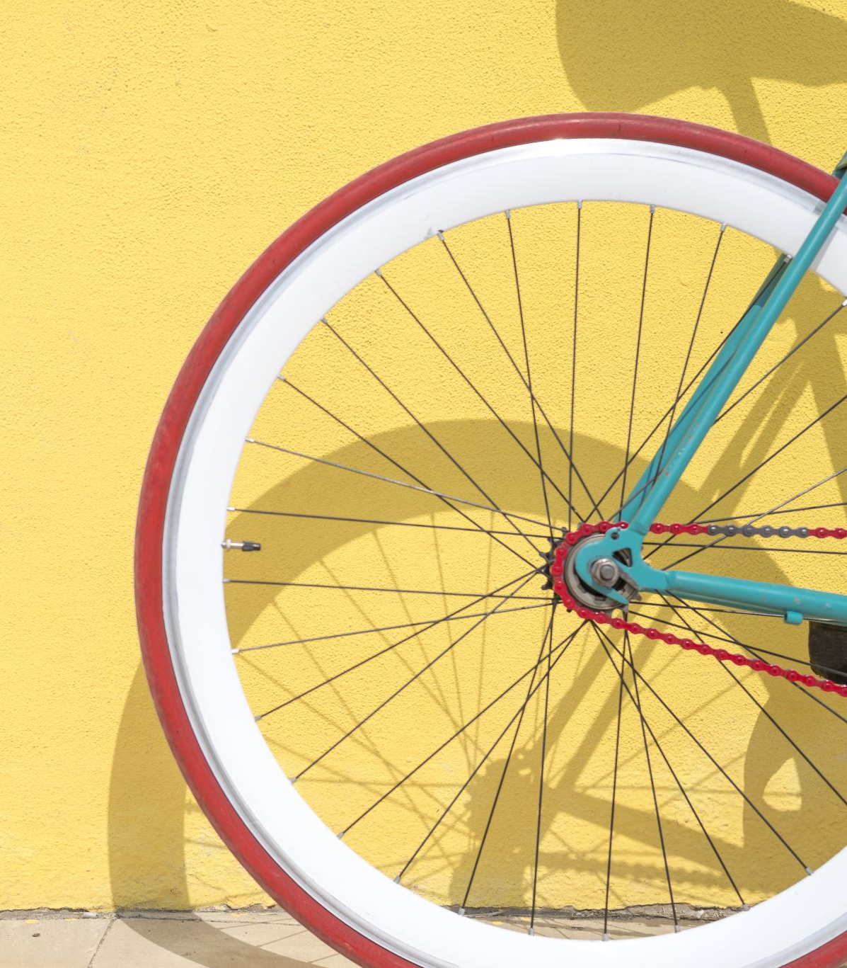
Cycle Parking in Thame
The availability of safe cycle parking encourages bicycle use in and around town.

Slide 2
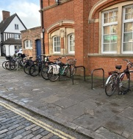
Town Centre
Ample provision for cycle parking can be found around Thame Town Centre.
However, the most-used cycle rack, outside the Town Hall, is closed for use during Town Centre events, and all cycle racks are out of use during the September Fair.

Slide 3
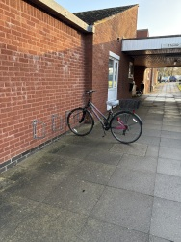
Community Facilities
Cycle parking is available at most Community Halls, including Thame Barns Centre and the Scout and Guide Headquarters.
Parking at the Health Centre is not up to standard – the rack provided isn’t suitable for most bikes and places cycles across the pedestrian path.
Cycle racks available at St Mary’s (at Barns Centre) and St Joseph’s Churches.
A cycle rack has been installed at the new allotments at Roman Way but no such facilities exist at the allotments at Stones Close, the Rugby Club or off Blackthorn Grange.

Slide 4
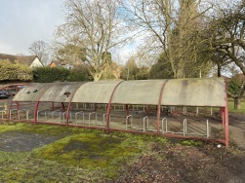
Sporting Venues
Cycle Parking is available at the Cricket Club (shared with Barns Centre), Tennis Club and Chinnor Rugby Club,
There are cycle racks at Thame Leisure Centre, (left) shared with LWS, but these are in a state of disrepair, and many potential users will be deterred from leaving cycles there.
No cycle parking could be found at Thame Football Club or the Skate Park.
Playgrounds – cycle racks at Southern Road Playground but not Elms Park or Queen Elizabeth Circle

Slide 5
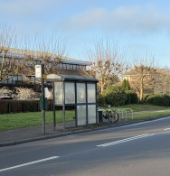
Transport Connections
The cycle rack at the bus stop on Aylesbury Road, outside CPM, allows bus passengers to cycle to and from their stop. Could this be provision be extended to other bus stops, such as the one on Oxford Road near Upper School?

Slide 6
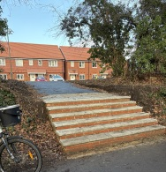
Other Observations
No cycle parking observed at employment centres – eg Howland Road Business Park, Dormer Road etc. Can local businesses be encouraged to install cycle racks?
Two sets of steps were recently installed to link the new Phoenix Park development with the Phoenix Trail. No ramps were installed to facilitate access by wheelchair, cycle or pushchair. Can this be rectified?

